Slide 1
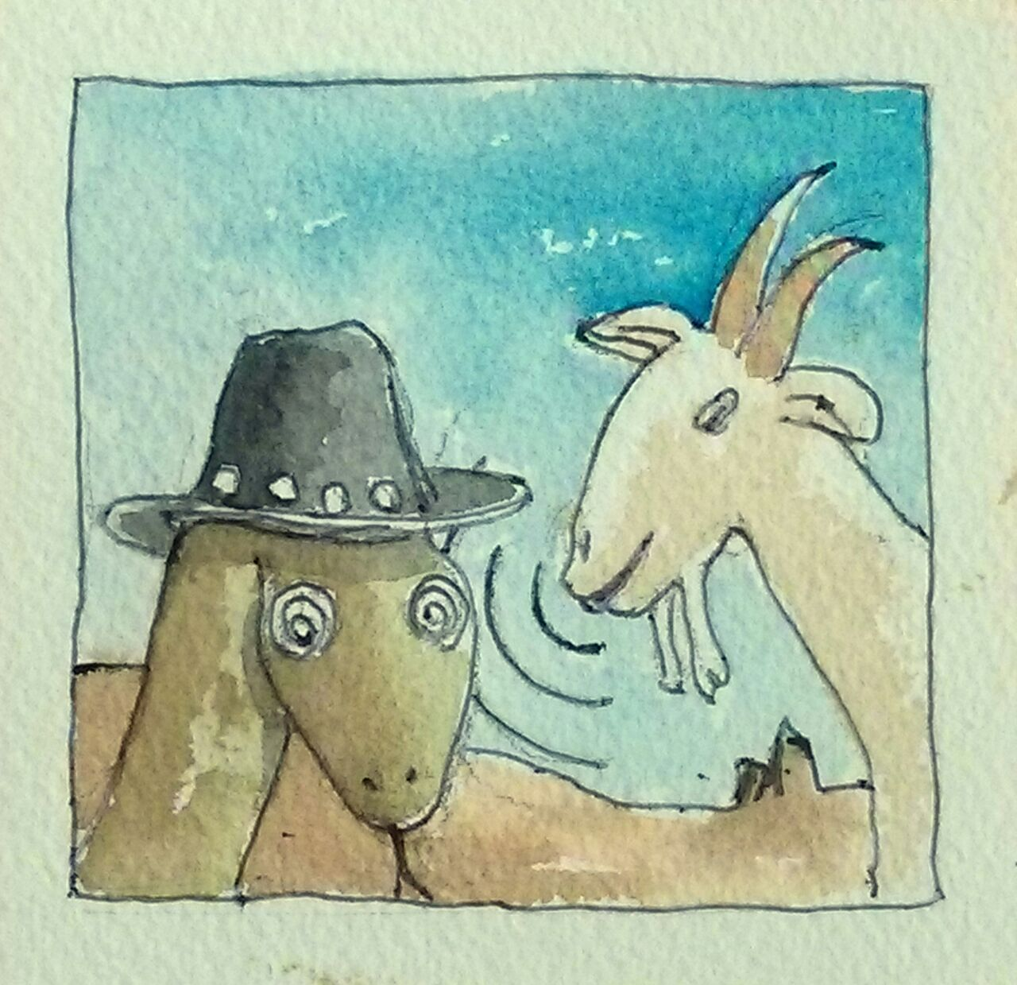
Animal husbandry in Python: taming the testing goat
Source: http://www.marinamele.com/

Slide 2
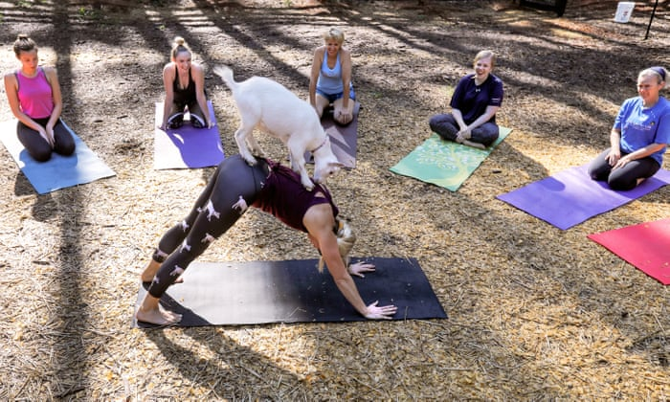
Testing? Goats? What is this?
Testing: Formal process of validating product features.
Goat: Multipurpose farm animal.
Source: theguardian.com

Slide 3
What sort of tests are there?
Exploratory / planned
Manual / automated
Functional
Performance
Unit
Stress
Tests testing the tests to test other tests that maybe test the functionality you never needed in the first place

Slide 4

The purpose of a goat is clear.
or is it...
But what of testing? Sounds like a lot of extra work.

Slide 5
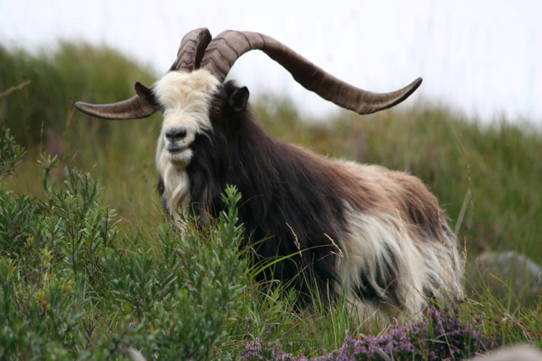
Why test?
Because the GOAT TELLS YOU SO!
Credit: Old Irish Goat Society

Slide 6
But seriously?
Testing improves reliability and resilience of your code by helping prevent feature loss.
By writing tests you become the first user of your code.
Anti-regression; writing a test that verifies every bug fix ensures it doesn’t re-appear later.
Having tests allows you to refactor with confidence
Extra valuable skill to have.

Slide 7
What’s a good test, then?
Single test focuses on a single thing
Minimum necessary setup to get the single thing done
Document how to run your tests and what they're doing
Make sure tests don’t depend on output from other tests
Test your code’s logic, not constants
Don’t test third-party library code
Plan test structure in advance
Automate your tests

Slide 8
Last word on automation
and another list..
Automation is short step from writing tests
Can be re-run quickly and easily
Need to test code anyway, but unplanned testing via users reporting bugs is worse them testing defensively.
Tests don't make mistakes when they run
Help formalize the test approach

Slide 9
Let’s see some code!

